Slide 1

Chrome Developer Tools

Slide 2
What are Chrome Developer Tools?
Tools built into the Chrome Browser that help web developers.
With these tools, developers can:
View source code (HTML, CSS and JS) for any web page.
Mouse over HTML elements to find where they are created in the code and how they are styled in the CSS.
See how a web page will look on a tablet or smartphone.
Debug their code.

Slide 3
Why Should I Use Chrome Developer Tools?
They’ll make your work go much faster because:
You can get ideas from other developers.
You can more easily debug HTML, CSS and JS code.
They let you see what your web page will look like on a variety of screen sizes (called “responsive design”).
Almost all web developer use them.

Slide 4
Source Code Viewer

Slide 5
View → Developer → View Source
View (and duplicate) the HTML code that creates the page structure.
Find out which HTML elements have which classes.
Read well-written HTML code.
Make sure it’s a reputable company website.
2 Ways to access the source code:
View → Developer → View Source.
Or use the keyboard shortcut: <CMD> + <OPTION> + U.

Slide 6
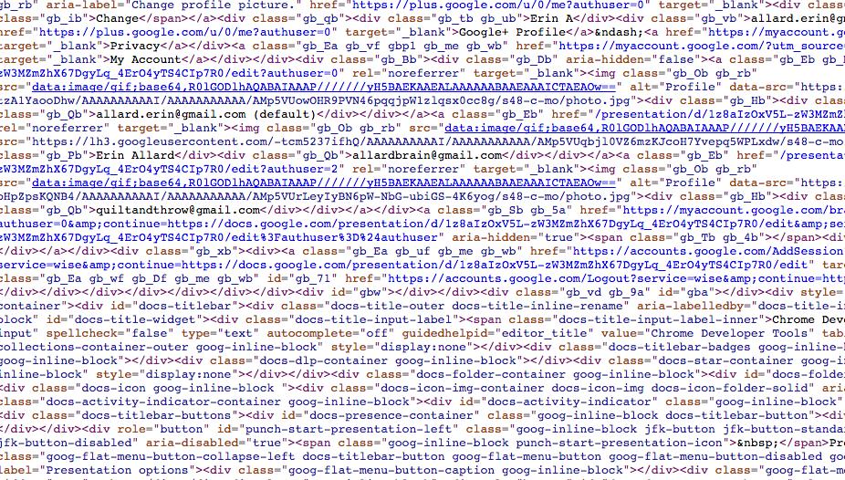
Yuck.

Slide 7

Quick Source Viewer (Chrome Extension)
Download Quick Source Viewer instead.
It’s a Chrome extension that “pretty prints” the source code.
Go to a website whose source code you want to view.
Click the Quick Source Viewer icon in upper right corner.
The source code is so much easier to read!

Slide 8
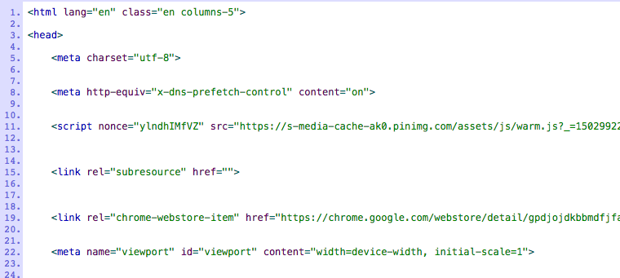
So much better!

Slide 9
Developer Tools

Slide 10
View → Developer → Developer Tools
All the benefits of viewing the source code PLUS.
View the CSS!
Great for finding out hex color values.
Great for finding out “How’d they do that?”
Mouse over page elements to see their relevant code.
See what a web page looks like on a tablet or smartphone.
2 Ways to access the Developer Tools:
View → Developer → Developer Tools.
Or use the keyboard shortcut: <CMD> + <OPTION> + I.

Slide 11
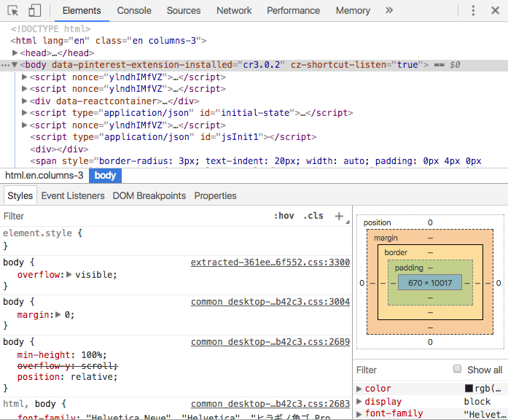

Slide 12
JavaScript Console

Slide 13
View → Developer → JavaScript Console
See if anything is printing to the JavaScript console
Errors? Expected output?
See if jQuery functions are working properly
Run JS code that’s embedded in an HTML file
3 Ways to access the source code:
View → Developer → JavaScript Console
Or use the keyboard shortcut: <CMD> + <OPTION> + J
Or click on “Console” to the right of “Elements” from the Developer Tools panel

Slide 14
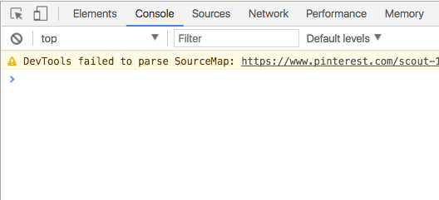
View → Developer → JavaScript Console

Slide 15
Questions about Chrome Developer Tools?

Slide 16
Dev Tools Resources
Dev Tools documentation
12 tricks to develop quicker using Chrome dev tools (video).
Mastering Chrome Developer Tools

